Slide 1
Network Health
Lightening Talk – Ashay Krishna -2017

Slide 2
What can we achieve
Latency issue
Packet drop
Alerting on Packet Drop or specific syslog
History of Latency inter and Intra Region

Slide 3
What we need
Linux servers at least two per region
Python installed with all modules
Some front page would be good, Flask or some lightweight report presentation
Cron set-up Jinxin also works
Failure alerting

Slide 4
What to check in code
Netmiko as SSH handeller
https://pynet.twb-tech.com/blog/automation/netmiko.html
Multithreading
Scapy
http://www.secdev.org/projects/scapy/

Slide 5
Script Discussion
Small range scanning script is user interactive
Will scan 10k+ devices with-in 5 min.
User need to provide name where output need to be saved.
Will write data, zip it and mail user.
Thread policing has been done forcefully for 100 devices.
Works well for Juniper, Cisco, Arista and Dell devices.
Can modify and convert into config script, have done with 10 max thread.

Slide 6
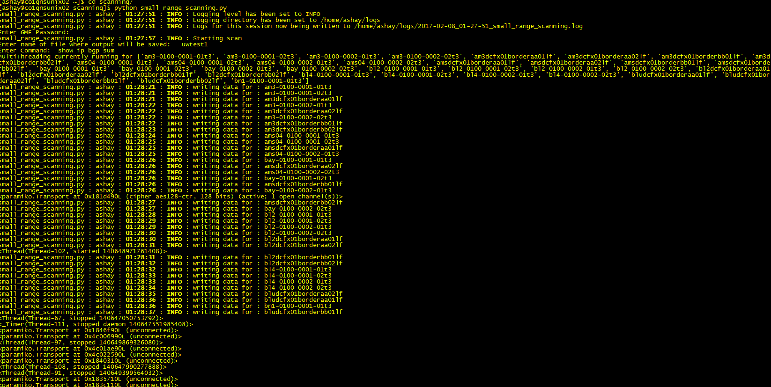
How it looks

Slide 7
What next with this
Scalability issue ?
How we can make pretty graph on data ?
Where to store data SQL is best option ?
Best sync process for all Linux boxes so script never fails ?
What else guys ☺

Slide 8
Thanks & Feedback

